Slide 1
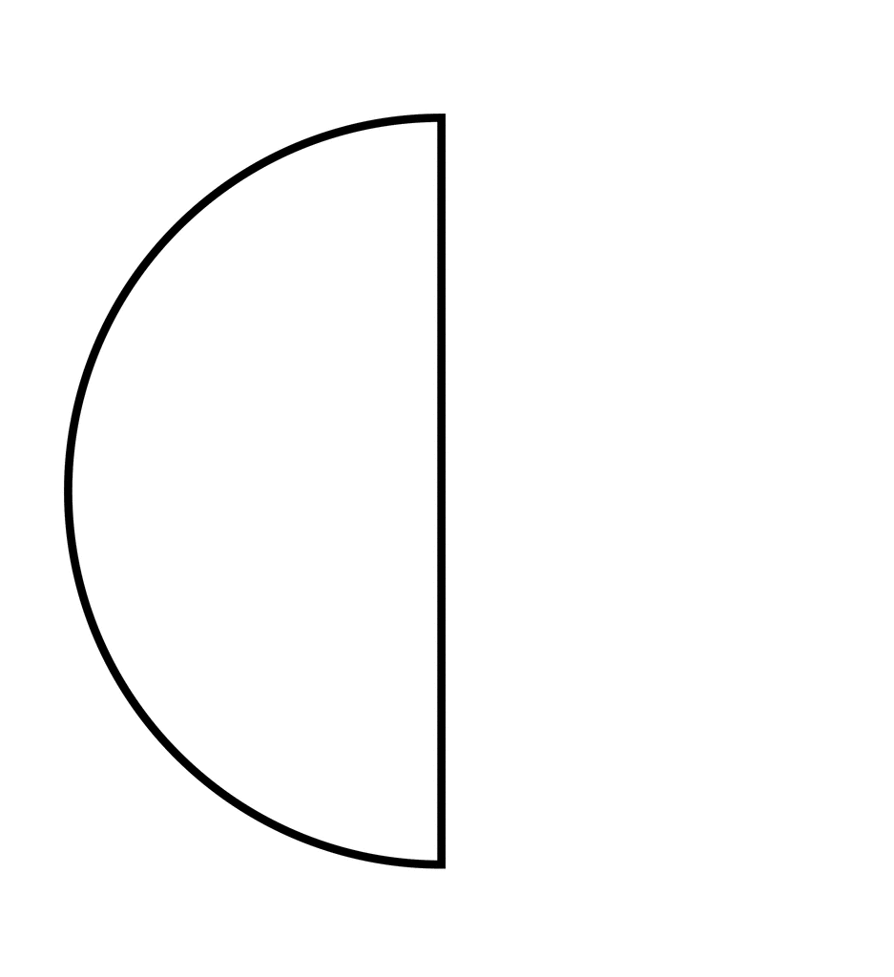
At a party a number of cupcakes were cut in half. Once the party finished 8 pieces remain. If you put them all together, how many “whole” cupcakes can you create from the pieces?
4
8 x 1/2 (or 8 lots of 1/2) =
So 8 x 1/2 gives the same answer as 8 ÷ 2

Slide 2
At another party, cupcakes were cut into quarters. Once the party finished, again 8 pieces remain. If you put them all together, how many “whole” cupcakes can you create from the pieces?
2
8 x 1/4 (or 8 lots of 1/4) =
So 8 x 1/4 gives the same answer as 8 ÷ 4

Slide 3

I have 4 cakes packed into containers that each contain 2 cakes? How many containers do I have?
4 cakes divided into groups of 2, gives us 2 groups.
Therefore 4 ÷ 2 = 2

Slide 4
I have 4 cakes packed into containers that each contain ¼ of a cake? How many packets do I have?
4 cakes divided into groups each containing a quarter of quarter of a cake, gives us 16 groups.
Therefore 4 ÷ ¼ = 16
Which is the same result as 4 x 4 = 16

Slide 5
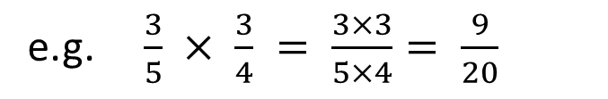
24
7
30
Date
Fractions
EQ – What do you do when you multiply or divide fractions?
To multiply fractions
Multiply the numerators together
Multiply the denominators together
e.g. $\frac{3}{5} × \frac{3}{4} = \frac{3×3}{5×4}= \frac{9}{20}$
To divide fractions
Use “copy change flip”
Copy the first fraction
Change divide sign to multiply
Flip the second fraction upside down
The reciprocal of a fraction is the fraction flipped over.
Always see if you can simplify the answer
e.g. $\frac{2}{3} ÷ \frac{4}{5}$ $becomes \frac{2}{3} × \frac{5}{4}=\frac{2×5}{3×4}= \frac{10}{12}=\frac{5}{6}$

Slide 6

Some examples
$\frac{5}{7} × \frac{8}{9}$ $= \frac{5×8}{7×9}= \frac{40}{63}$
$\frac{5}{7} ÷ \frac{8}{9}$ $= \frac{5}{7} × \frac{9}{8}$ = $\frac{5×9}{7×8}= \frac{45}{56}$

Slide 7
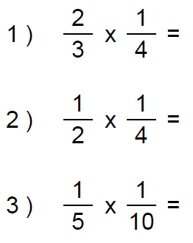
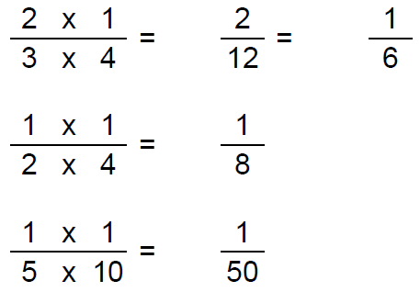
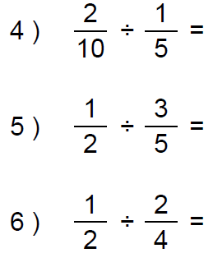
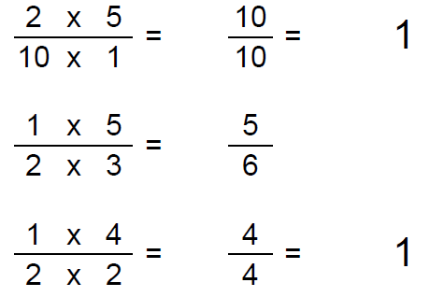
Let’s try these together

Slide 8
Task
10

Slide 9
Remember!

Slide 10
Notes Review
24, 7 ,30
Date
Title
Essential question
Notes complete
Notes complete with colour and diagrams
Questions completed
Contents page filled in
Formula page filled in

Slide 11
Homework
Review your notes and write a summary answering the essential question.

